Slide 1

CS Live 2025
Member feedback

Slide 2
Member survey

Slide 3
172
Survey Participants

Slide 4
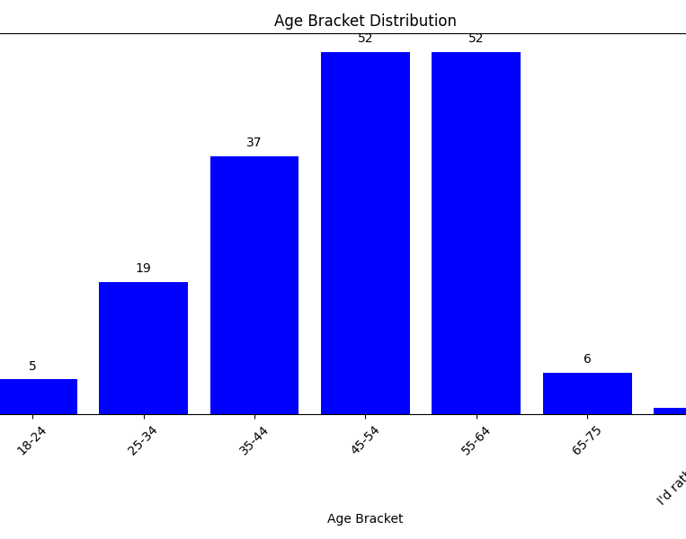
Population surveyed

Slide 5
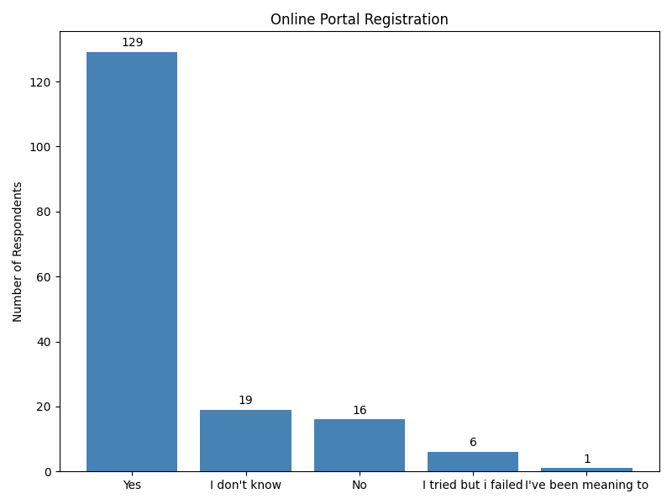
Population surveyed

Slide 6
Results
What was your main reason for enrolling? | Number of Respondents
I didn't think about it – I was auto-enrolled | 92
I see a lot of value in pensions | 44
I like to be prepared, just in case | 18
Everyone around me was enrolled | 10
I took advice from someone else | 6
Planning retirement | 1
(No response / missing) | 1
Feelings about Retirement | Frequency
I have a vague idea of what I want | 72
I'd need to talk with someone | 44
I know exactly what I want to do | 35
I haven't really thought about it | 21
How much do you agree with the following statements? | Average Participant Score
I see a pension as enabling my future | 4.35
I see a pension as a blocker to the life I want to live now | 1.84
I trust my pension provider | 3.83
Retirement feels like a long way away | 3.11
I understand how pensions work | 3.06
I believe I can make better returns on my money than my pension provider can | 2.40
Locking my money in a pension makes me feel secure about my future | 4.06
Locking my money in a pension makes me feel a lack of control over my own money | 2.18
I need to improve my knowledge of pensions | 4.13
Preferred application for retirement | Frequency
I'd prefer to speak to someone | 118
I'd prefer to self-serve online | 54
5 = Strongly agree
1 = Strongly disagree

Slide 7
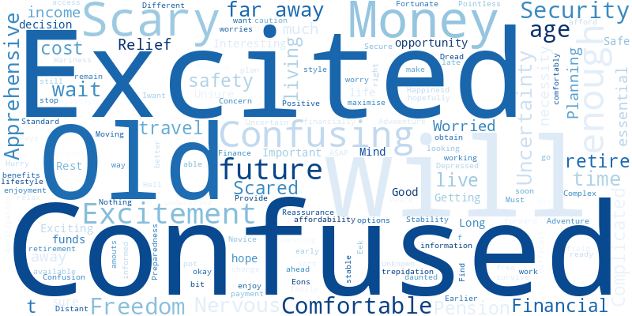
What are the first words that come to mind when describing your feelings about retirement and pensions?

Slide 8
Engagement Activity
How often do you engage with the following activities?
Engagement Activity | Never | Seasonal | Weekly | Yearly
I check or update my nominated beneficiaries | 69 | 21 | 1 | 81
I check the progress of my pension (Benefit Statements) | 46 | 29 | 4 | 84
I check or update my personal information e.g. email address | 62 | 22 | 0 | 87
I use calculators to help me estimate my pension at retirement | 58 | 34 | 8 | 59
I contact for support on my pension | 119 | 18 | 1 | 33
I check what my loved ones will receive using death benefit illustrations | 83 | 24 | 1 | 64

Slide 9
Survey biases
As the survey was conducted at CS Live pensions stand, the participants were more likely to be interested in pensions and retirement.
They were likely closer to retirement than the average population and more likely to opt into their pension.

Slide 10
Anecdotal feedback
Talking to members and MyCSP colleagues

Slide 11
Learnings about the scheme and current processes
Retirement and modelling
The modeller defaults to show the maximum lump sum, which is misleading given the different scheme rules.
Partial retirement is available but is seen as complex and not well-explained.
Gaps in service under 5 years are treated as continuous for pension purposes.
Transfers must be completed within 12 months of joining, but delays in processing or members being unaware of the timeframe can cause members to miss this window.
Effective Pension Age (EPA) allows members to retire earlier by up to three years (e.g. at 65 instead of 68) but unclear whether this is reflected in the modeller.

Slide 12
Learnings about the scheme and current processes
Access and communication
Login issues are common, especially when using work emails or devices with security updates.
Some members prefer postal communication for security reasons.
Members do not receive emails when they become eligible to retire, leading to confusion.
Archived payroll access (e.g. payslips, P60s) are problematic for some users.

Slide 13
Anecdotal feedback
Member wants / requests

Slide 14
Member understanding / confusion
Pension structure and Scheme rules
Confusion about classic vs alpha schemes and how they interact (e.g. different retirement ages, lump sum rules).
Questions about partial retirement, deferred pensions, and returning after a break (e.g. 5-year rule).
Uncertainty around EPA and how it affects modeller inputs.
Concerns about transfers – especially the 12-month window and delays causing missed opportunities.
Requests for clarity on promotion impacts, gaps in service, and how stints are calculated.
Questions about inflation and whether it's factored into modeller or ABS figures.
Misunderstanding of 25% lump sum rule – especially among classic members who expect 3x final salary.
Interest in understanding tax implications (e.g. McCloud remedy tax payments).
Want to know if modeller is based on live data or ABS.

Slide 15
Member understanding / confusion
Retirement planning and modelling
Want to know what they’d get if they retired today.
Confusion about what the modeller shows: current, future, or additional pension.
Want to model scenarios like going part-time, taking no lump sum, or buying additional pension.
Questions about how to retire – lack of communication or guidance.
Want to understand what happens if they leave the Civil Service and whether ABS gives enough information.

Slide 16
What members want from their administrator and tools
Members want a modeller that:
  Shows all options, not just defaults.
  Allows input of salary, current age, promotion scenarios and partial hours.
  Includes a glossary or clearer terminology.
  Shows total pension or estimated salary on the homepage.
  Allows for scenario comparison (e.g. Armed Forces calculator style).
  Is consistent across App and website.
Want to know if modeller includes live data or from ABS.
Request for partial retirement modeller and related literature.
Want to see salary used in calculations to ensure accuracy.

Slide 17
What members want from their administrator and tools
Communication and support
Want clearer scheme breakdowns and explanation of options.
Prefer mail for security (some members).
Want content to explain login issues (e.g. work email restrictions).
Request for content prompts on how to save pension money and where to get advice.
Frustration with login issues, archived payroll access, and registration pain points.
Desire for personalised content based on region (UK/Scotland/Wales).
Expect duty of care and proactive communication (e.g. retirement readiness emails).

