Slide 1
CSPS Employer Workshops
London 8^{th,} 9^{th,} 10th October 2024
Commercial in Confidence

Slide 2
Retire Online - Pain Points
Use of different system
Data is on multiple platforms
Access to historic data
Lack of communication
No central comms strategy
Employer helpline isn’t efficient
Inaccurate info at call center
Lack of update on retirement cases
Timeframe to retire is 4-6 months, but the case is only picked up 2 months prior to the estimated retirement date
A lot of back and forth for DR1
Lack of government SLA for data request
Lack of process understanding
Lack of engagement from members
Lack of MI data to identify trends
Triage process is unclear
Modeller isn’t accurate for partial retirement
No pre-quote available
Quote is issued by 2nd class post
Quote is often delayed, which causes issues over the last day of work.

Slide 3
Retire Online - Opportunities
Data triage
Transparency over SLA
Improve DR1 form and process
Online notification instead of emails
Clear tracking
Read only access to member records
Be able to see what members see
Data cleanse
Digitalise process, no manual forms
Consistency in format and language
Building forms validations
Retirement workshops
Assess pensions for members approaching retirement.

Slide 4
Task Manager - Pain Points & Opportunities
Lack of SLA
Very manual processes/paper
Terminology used is complex
Lack of visibility
Query response chasing
A lot of back and forth
Training not being free
Historic data not held by CSP
New joiners enrolled incorrectly (not sure who
should be responsible)
E-mail doesn't comply with security
Use of different case code between Employer and administrator.
Ability to upload files
Electronic paper trail
Improve comms.
Employer to access a portal to raise queries directly with provider
Case tracker
Transparency/visualise process

Slide 5
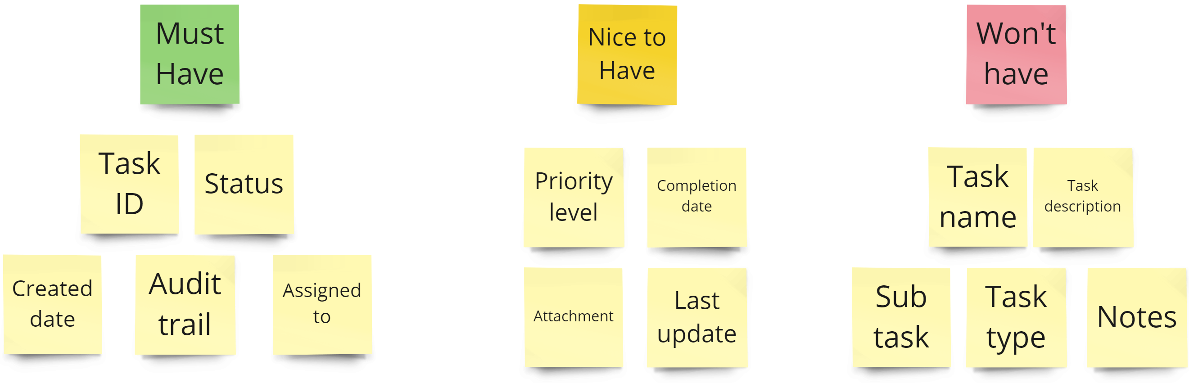
Task Manager – Task details prioritisation

Slide 6
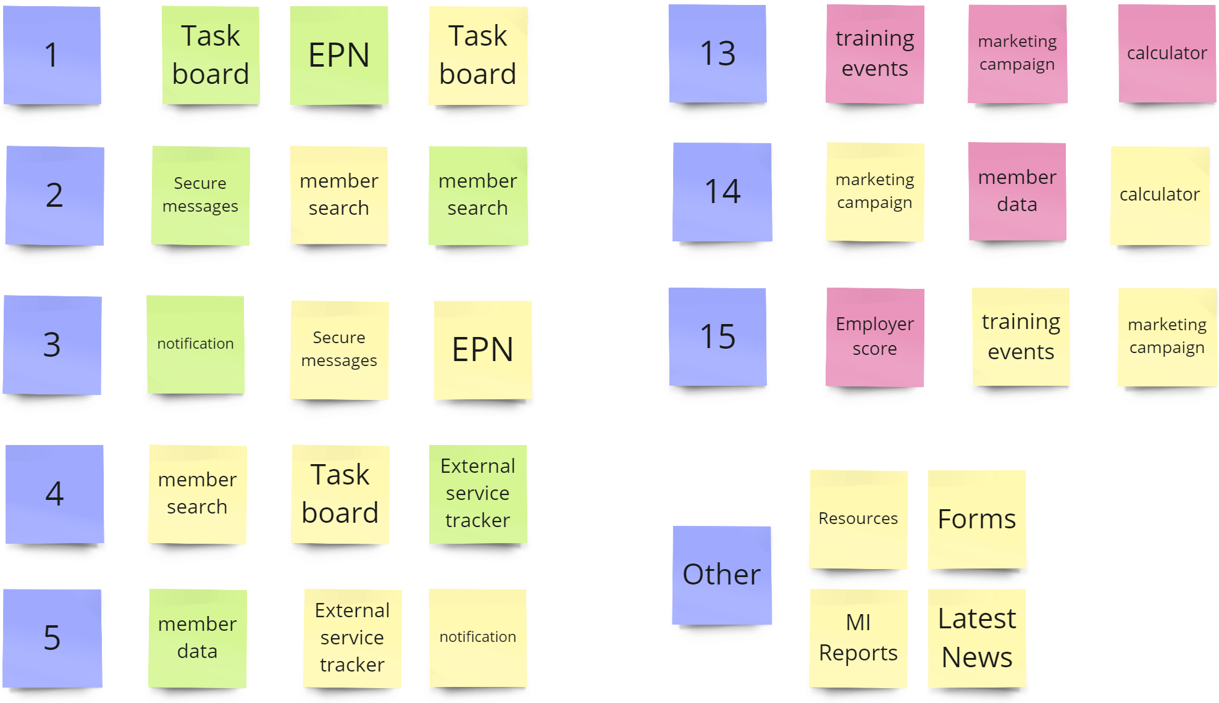
Dashboard – Features prioritisation
Further features emerged during the three days workshops:
Error and warning reports
Link to Legal & General
Interface guidance and scenario
Number of members signed in
Budget management.

